Slide 1






Lecture 34:
Route Parameters
Course - Web Development - II
-By
Instructor Name
welcome@krmangalam.edu.in
Sohna Road,Gurugram,Haryana 122103

Slide 2

| Table of Contents
Route Parameters & Nested Routes.
Dynamic routing -useParams
References.
The End.

Slide 3

|
Think of Instagram: when you go to /profile/john vs /profile/emma, does Instagram load two different apps — or just one route that changes based on the username?

Slide 4
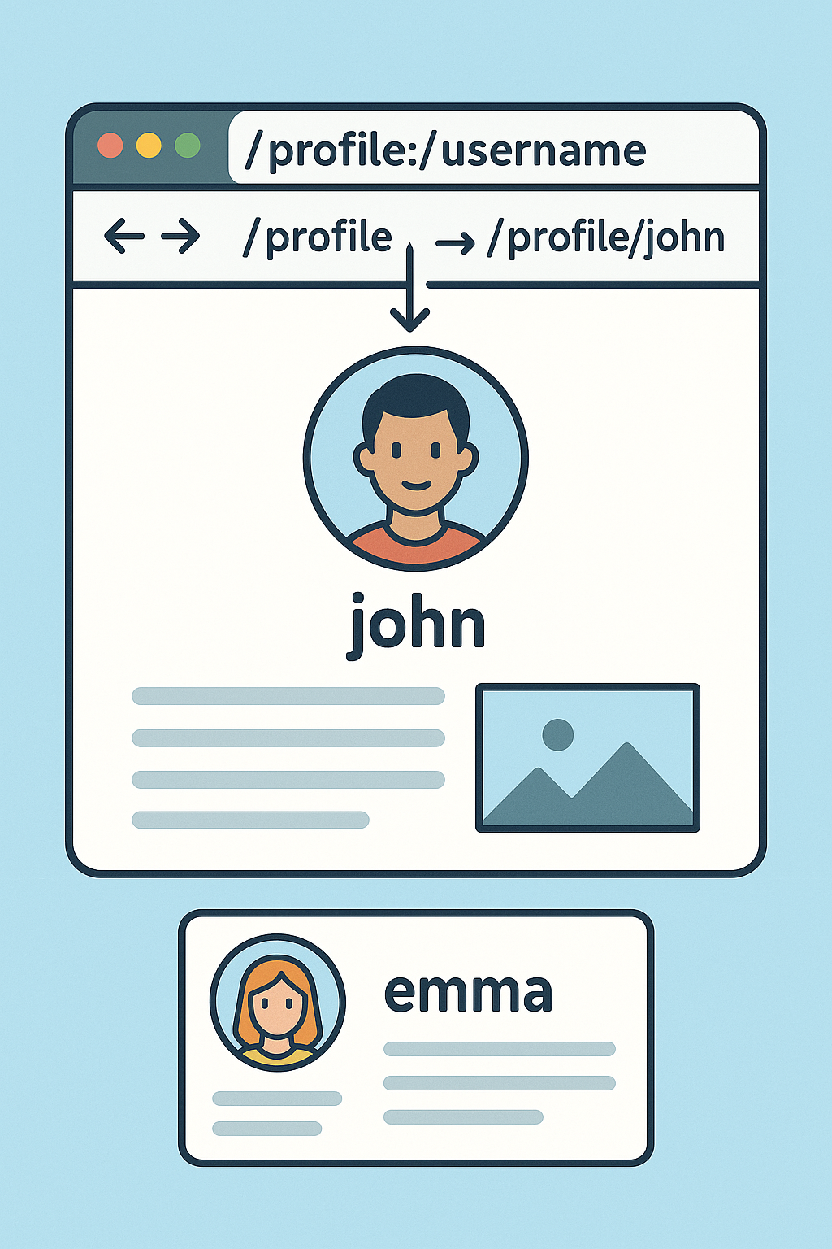
|
Think of Instagram: when you go to /profile/john vs /profile/emma, does Instagram load two different apps — or just one route that changes based on the username?
It’s not loading two different apps — it’s the same route that changes dynamically based on the username.
In React Router, we use a Route Parameter. For example, /profile/:username is one route, and :username is a placeholder.
So when you visit /profile/john or /profile/emma, React Router dynamically updates the content by filling in the parameter, and shows the correct profile.

Slide 5
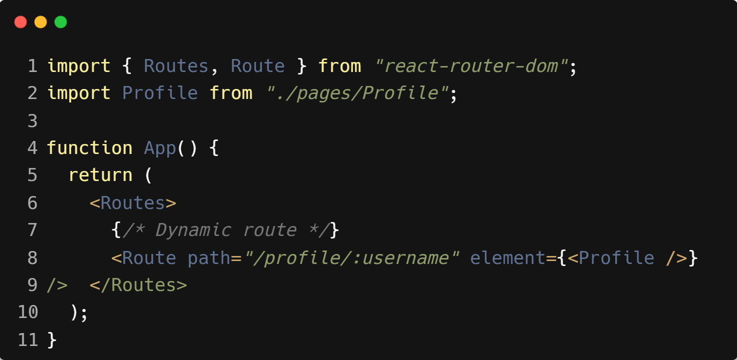
| Route Parameters
Route parameters let us create dynamic routes.
Instead of hardcoding paths, we use placeholders (like :id or :username).
They allow one route to handle multiple variations.
Example :

Slide 6
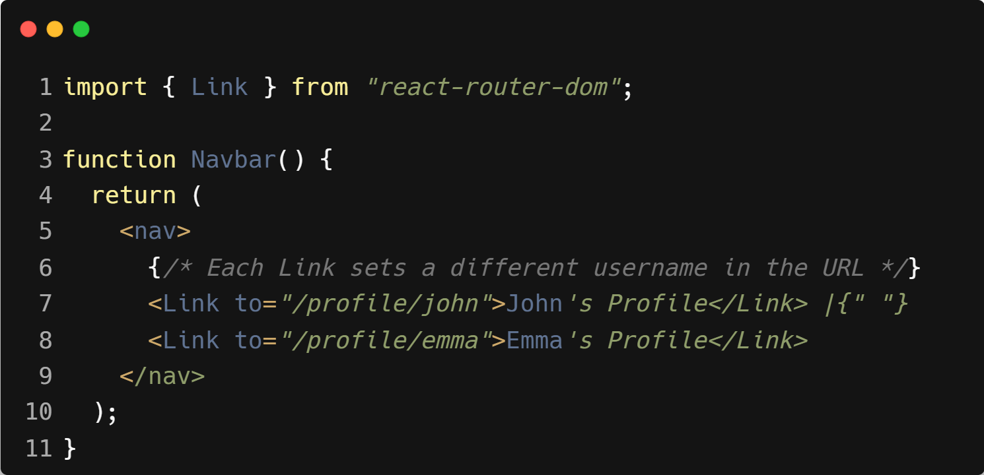
| Setting :username using Link

Slide 7
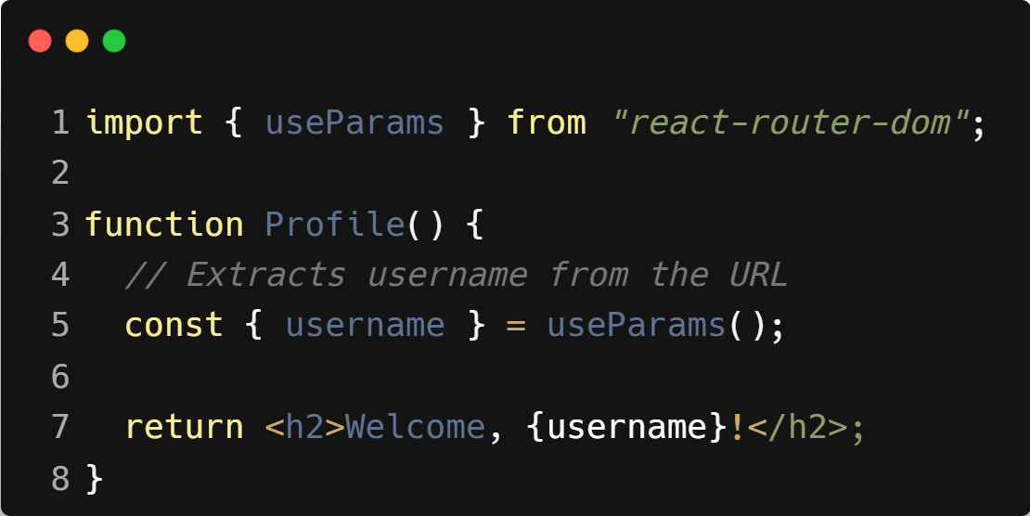
| Accessing the Parameter with useParams

Slide 8

|
If you build a dashboard with a sidebar and topbar — would you rewrite the sidebar & topbar again for every page?

Slide 9
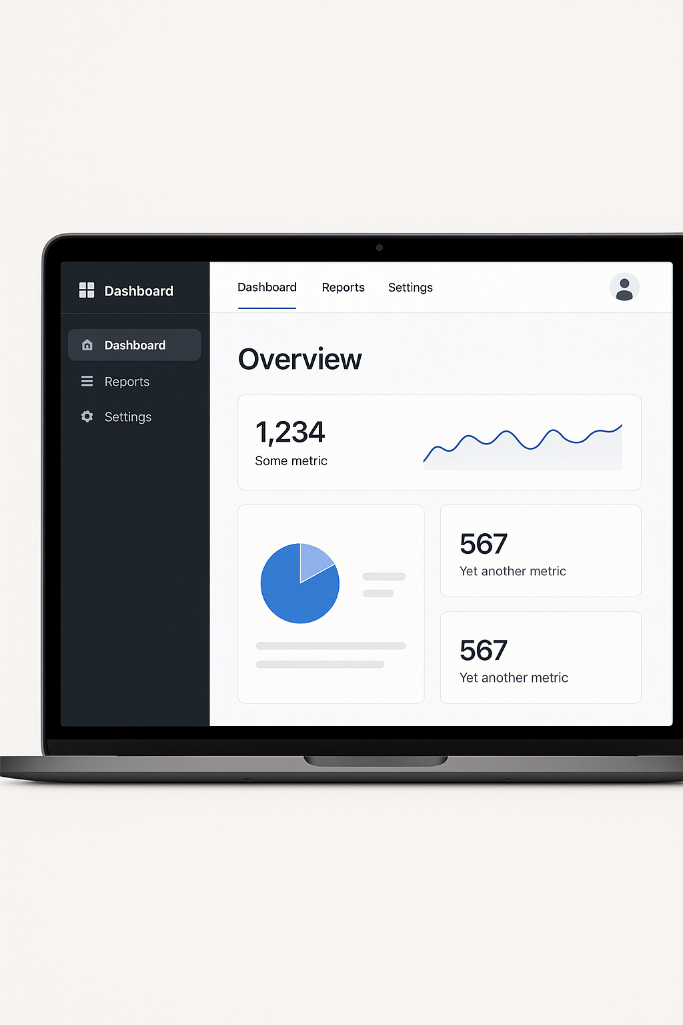
|
If you build a dashboard with a sidebar and topbar — would you rewrite the sidebar & topbar again for every page?
No. With Nested Routes, you keep the sidebar & topbar in the parent route (/dashboard),
And only swap the child routes (/dashboard/overview, /dashboard/reports, /dashboard/settings) inside it using <Outlet />.

Slide 10
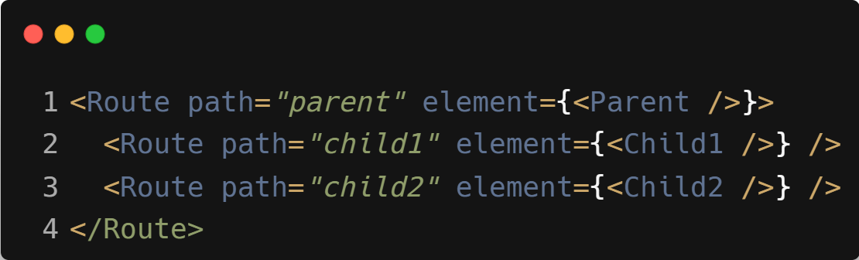
| Nested Routes
Nested routes let you build a parent route (like /dashboard) that has common UI (sidebar, header, etc.),
And then load child routes (like /dashboard/overview, /dashboard/reports) inside it — without losing the parent layout.
Syntax :

Slide 11
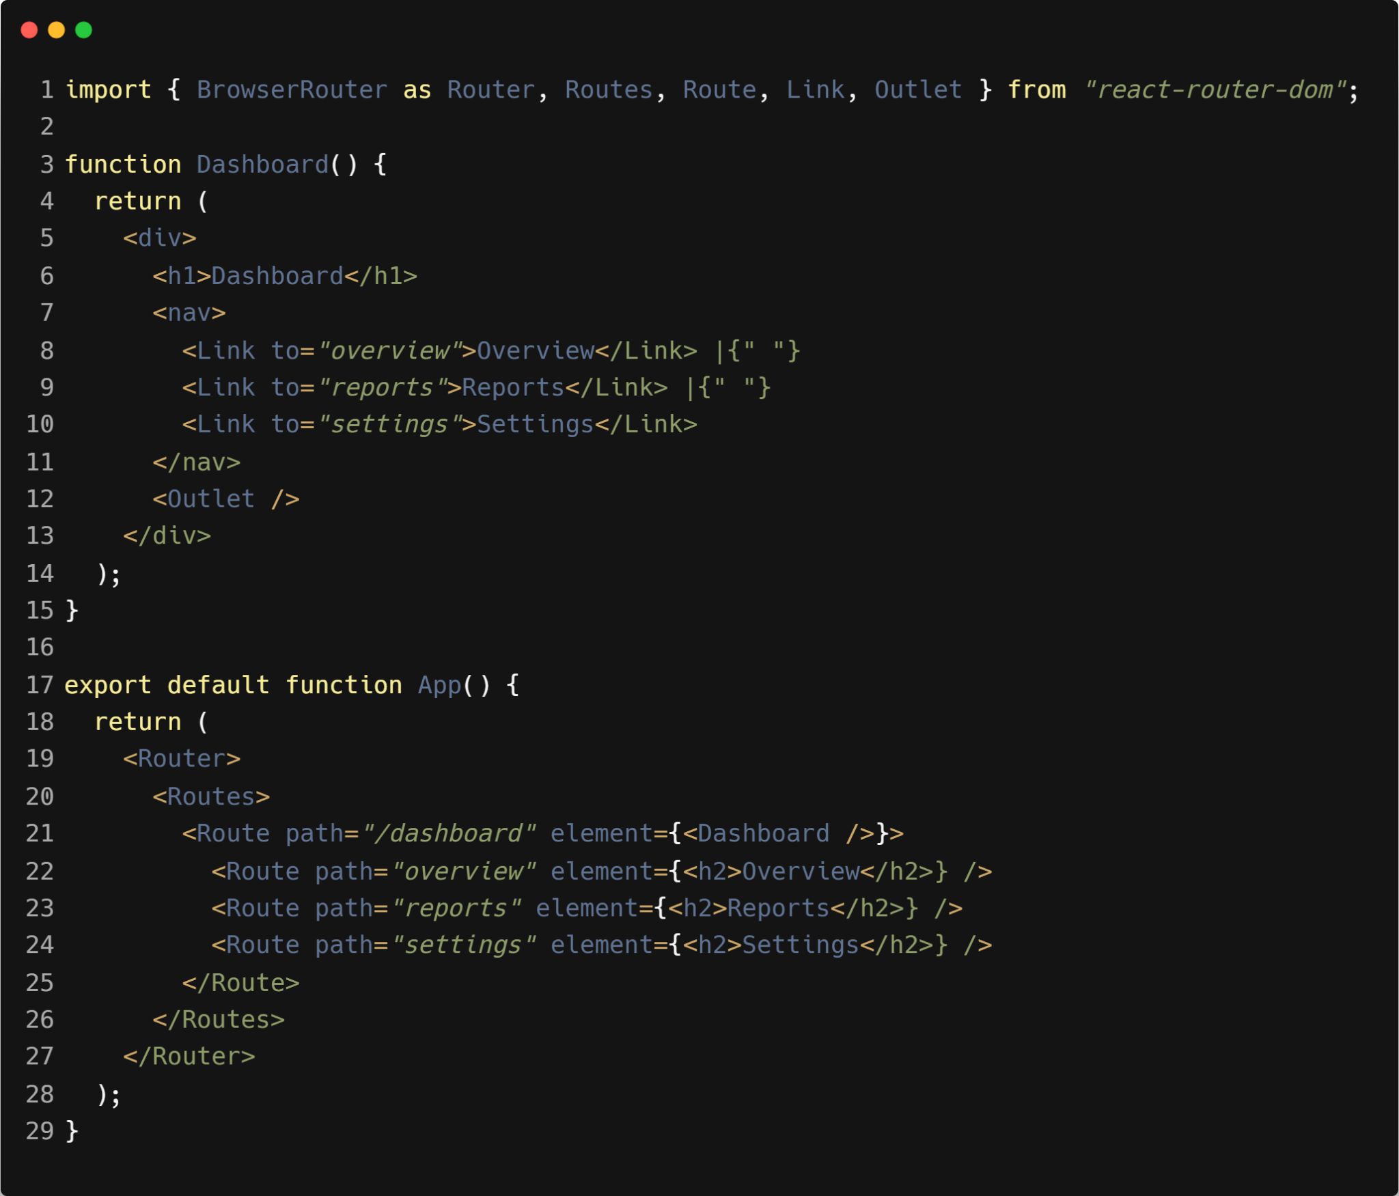
| Example : Nested Routes

Slide 12
| Example : Nested Routes

Slide 13

| Coding Questions
2. Accessing Route Parameters
Task :
Create a UserProfile component that can display a user's ID from the URL.
Define a route with the path /users/:userId.
In the UserProfile component, use the useParams hook to access the userId from the URL.
Display the user ID in a heading.

Slide 14
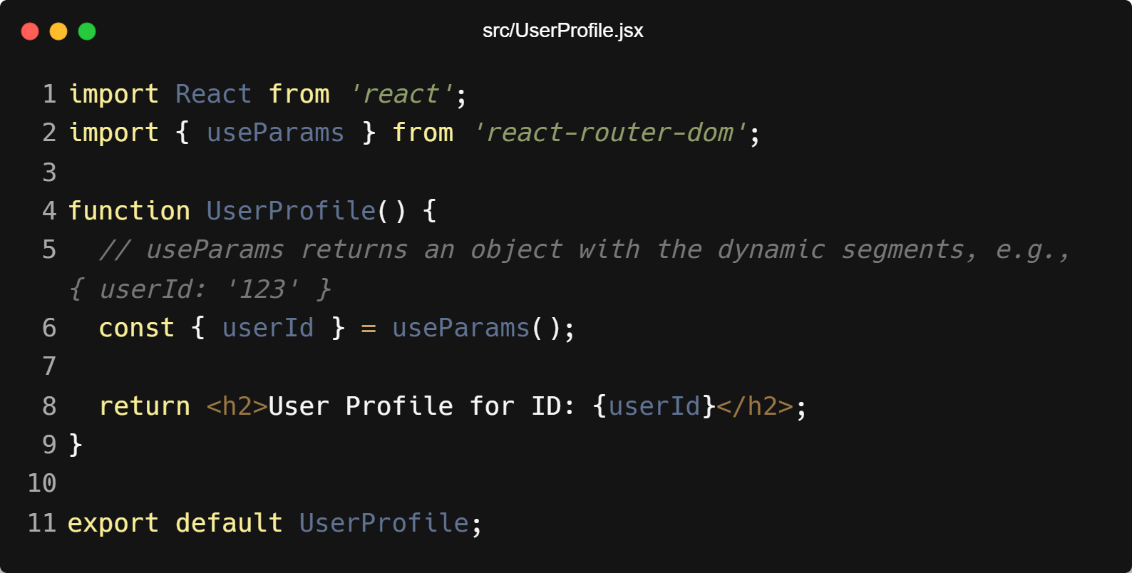
| Coding Questions
Solution :

Slide 15
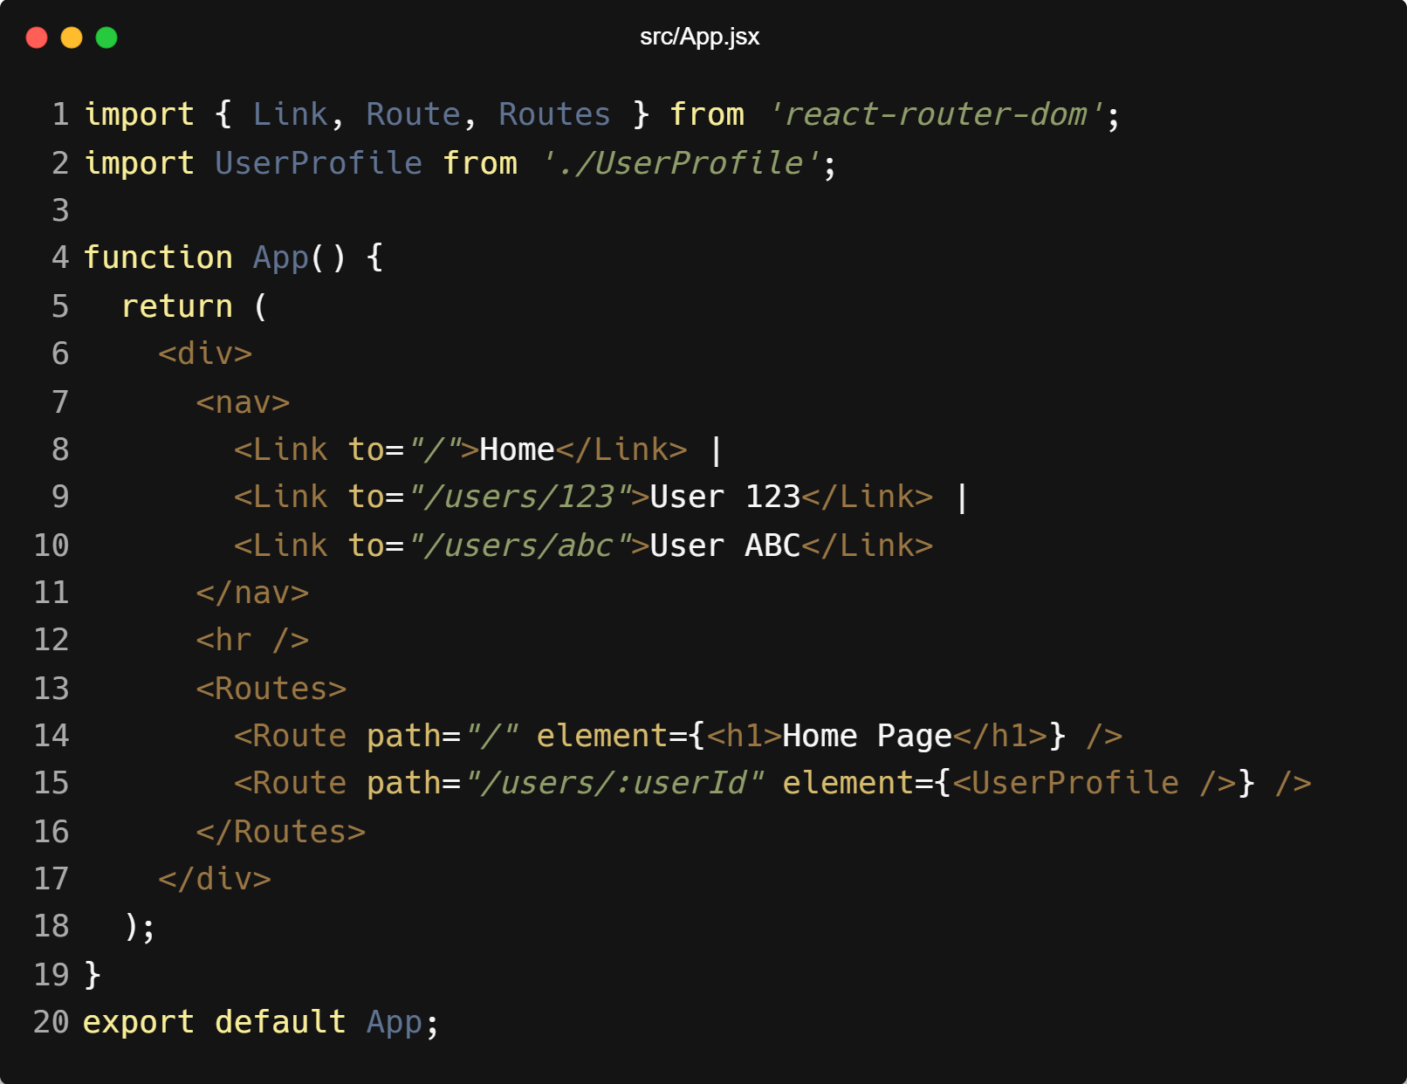
| Coding Questions
Solution :

Slide 16
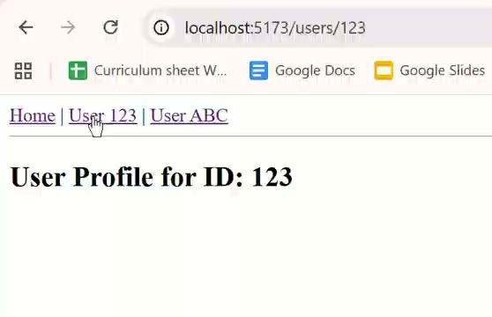
| Coding Questions
Output :

Slide 17
| Check Your Understanding
Question : What is the main purpose of React Router in a single-page application (SPA)?
Options : a) To fetch data from a server.
b) To manage the component's state.
c) To enable navigation between different views or components without causing a full page reload.
d) To style the components.
Answer : c) To enable navigation between different views or components without
causing a full page reload.
Explanation:
React Router synchronizes the UI with the URL, allowing you to create a multi-page feel in an application that only ever loads its initial HTML page once.

Slide 18
| Check Your Understanding
Question : To enable routing in your application, which component from react-router-dom
must you wrap around your root component (e.g., <App />)?
Options : a) <Link>
b) <Routes>
c) <BrowserRouter>
d) <Route>
Answer : c) <BrowserRouter>
Explanation:
<BrowserRouter> is the top-level component that uses the browser's History API to create clean URLs and manage the routing context for your entire application.

Slide 19
| Check Your Understanding
Question : What is the key difference between a standard <a> tag and React Router's <Link>
component?
Options : a) <Link> can be styled with CSS, but <a> cannot.
b) <a> causes a full page reload, while <Link> handles navigation on the client-side without a
reload.
c) <Link> is used for external URLs, while <a> is for internal paths.
d) There is no difference; <Link> is just a different name.
Answer : b) <a> causes a full page reload, while <Link> handles navigation on the
client-side without a reload.
Explanation:
Using <Link> is crucial for preserving the single-page application experience. It prevents the browser from making a new request to the server, instead letting React Router handle the view change.

Slide 20
| Check Your Understanding
Question : How do you define a route path that can match dynamic values, like a user ID?
Options : a) path="/users?id"
b) path="/users/*"
c) path="/users/:id"
d) path="/users/{id}"
Answer : c) path="/users/:id"
Explanation:
The colon (:) syntax in a path string signifies a URL parameter. React Router will match any value in that segment of the URL (e.g., /users/123) and make 123 available as a parameter named id.

Slide 21
| Check Your Understanding
Question : What is the primary advantage of using the <NavLink> component over <Link>?
Options : a) It is faster.
b) It can navigate to external websites.
c) It can automatically apply a style or class (like .active) when its path matches the current URL.
d) It is required for creating nested routes.
Answer : c) It can automatically apply a style or class (like .active) when its path
matches the current URL.
Explanation:
<NavLink> is specifically designed for navigation menus where you want to visually highlight the link corresponding to the currently active page, improving user experience.

Slide 22
| References
MDN Web Docs : Comprehensive and official documentation for JS. 🔗https://developer.mozilla.org/en-US/docs/Web/JavaScript
W3Schools – JS Tutorial : Beginner-friendly JS tutorials with examples and interactive editors. 🔗 https://www.w3schools.com/js/
react.dev - A comprehensive, tutorial-style website that deeply explores core React concepts, including components, state, effects, and hooks, through interactive examples and in-depth explanations.
🔗https://react.dev/

Slide 23
Thanks
For
Watching
Course - Web Development - II
welcome@krmangalam.edu.in
Sohna Road,Gurugram,Haryana 122103

